Slide 1
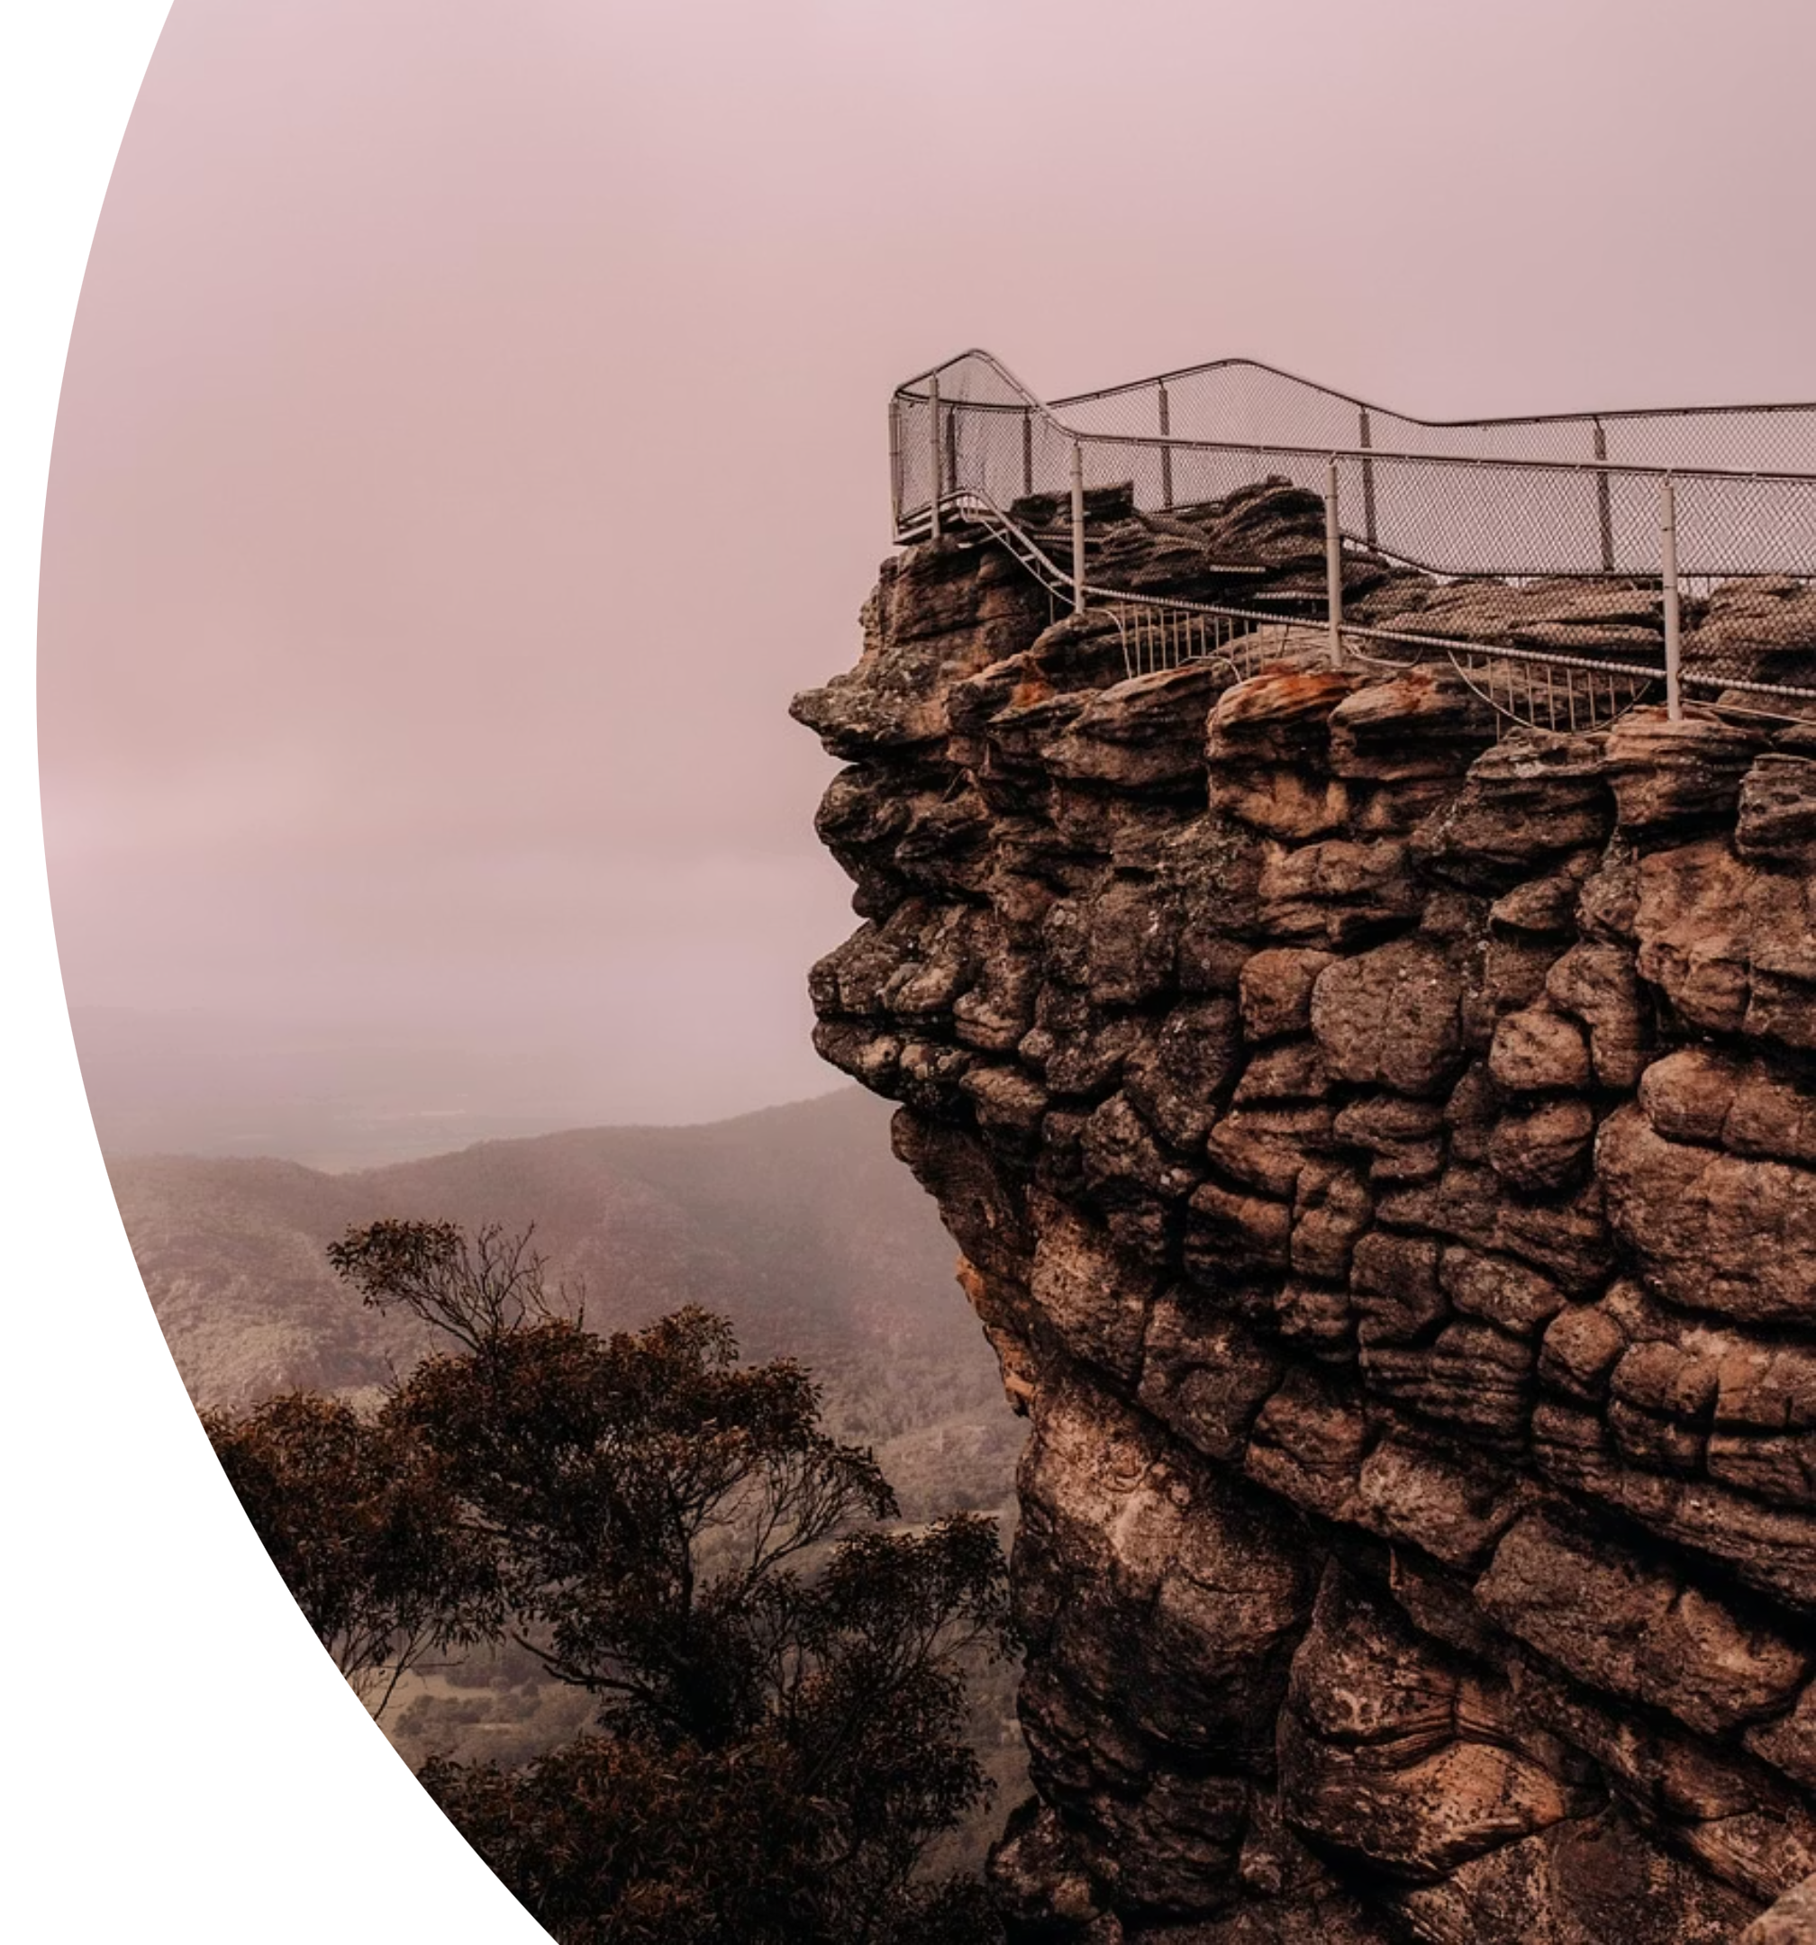
Structure and trends in the consultancy industry

Slide 2

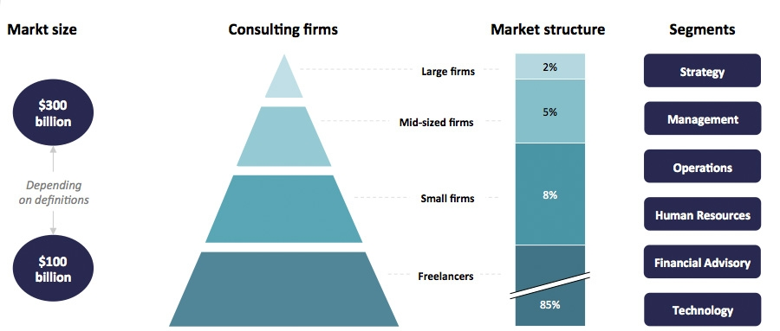
See https://www.consultancy.uk/consulting-industry - beware that numbers vary widely
Global consultancy industry
Law : ~900 bn USD | Staffing & Recruiting: ~400 bn USD
Compare:

Slide 3
Not a Global Industry
70% of fees
This isn't simply about wealth: consulting as we know it is a distinctly Anglo-American pattern. (Sturdy & O'Mahoney, 2018)
Five Countries
USA, UK, Canada, Germany and France dominate consulting.
The demand for external advice isn't natural; it's shaped by how a country's economy and culture are organized.
Alternatives: knowledge-sharing in industry associations or government institutions. Developing talent internally rather than importing it. Focusing on (internal) continuous improvement rather than (external) best practice.

Slide 4


The Pyramid Is Crumbling
Traditionally, consultancies structured as pyramids - many analysts support fewer project managers and partners (with 'up or out' promotions)
December 2025: McKinsey announced 10% job cuts – partly due to (expected )AI automation, internally and with clients.
How will that reshape career pathways/HR requirements? How far will it go?

Slide 5
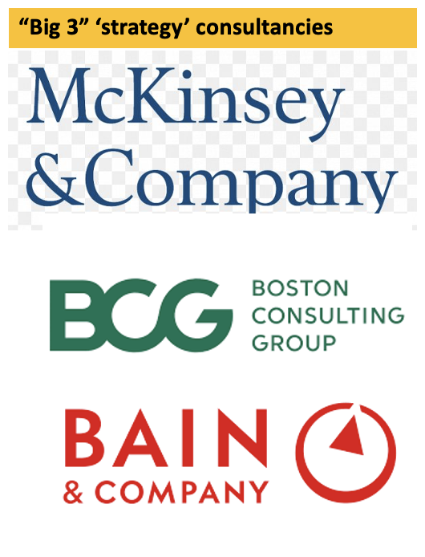
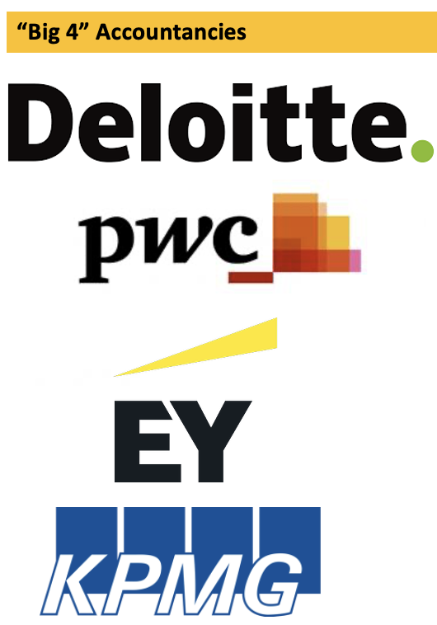
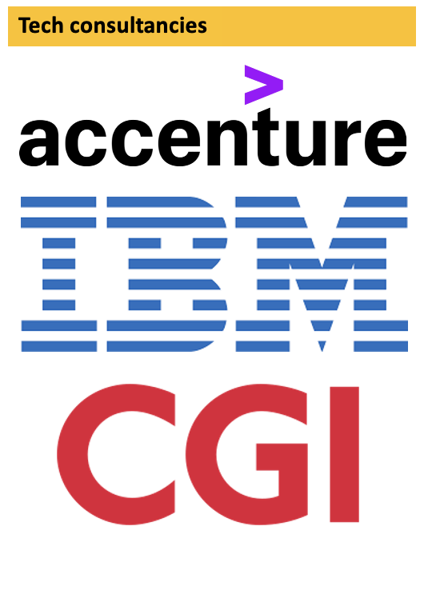
Value is moving
Specialised Boutiques?
Freelancers?
Newly valuable question: How can I help people act on what they know?
Notes:
For strategy: information asymmetry eroding – clients have access to the same data, and often the same people working in-house
Implementation focused consultancies are growing twice as fast – it’s hard to make change happen among people – and to automate that stakeholder engagement

Slide 6
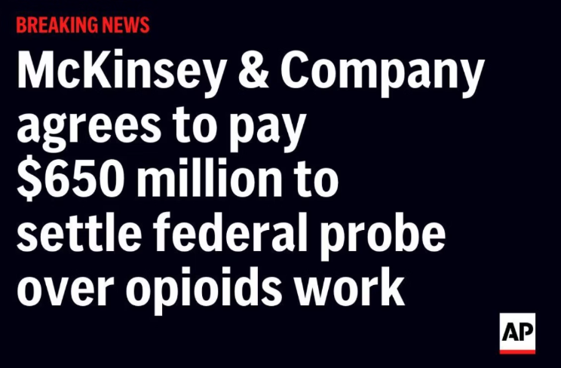
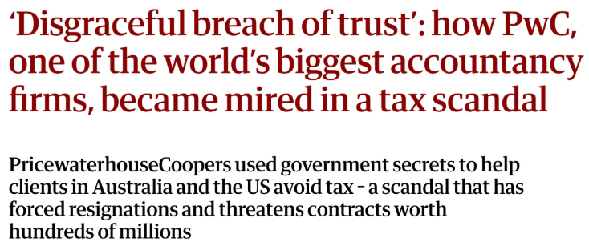
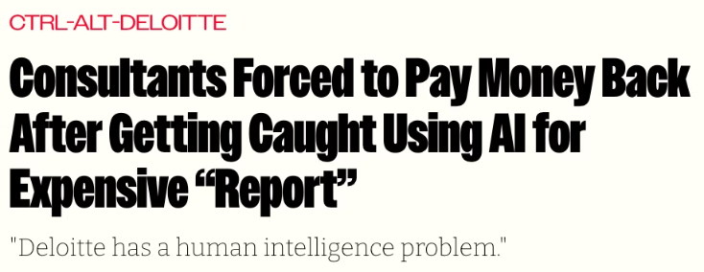

The Reputation Problem
The industry is facing questions it hasn't had to answer before. Recent years have brought unprecedented public scrutiny:
No Safety Net
There's no mandatory professional regulation, no licence to lose. Reputation is all there is.
There have always been scandals - but alongside AI replacement narratives, budget-conscious clients and social media scrutiny, professional standards matter.
If you're going to work in this industry, you need to think about ethics not as compliance but as professional identity.
What are you willing to do? What aren't you? Where are the lines?

Slide 7

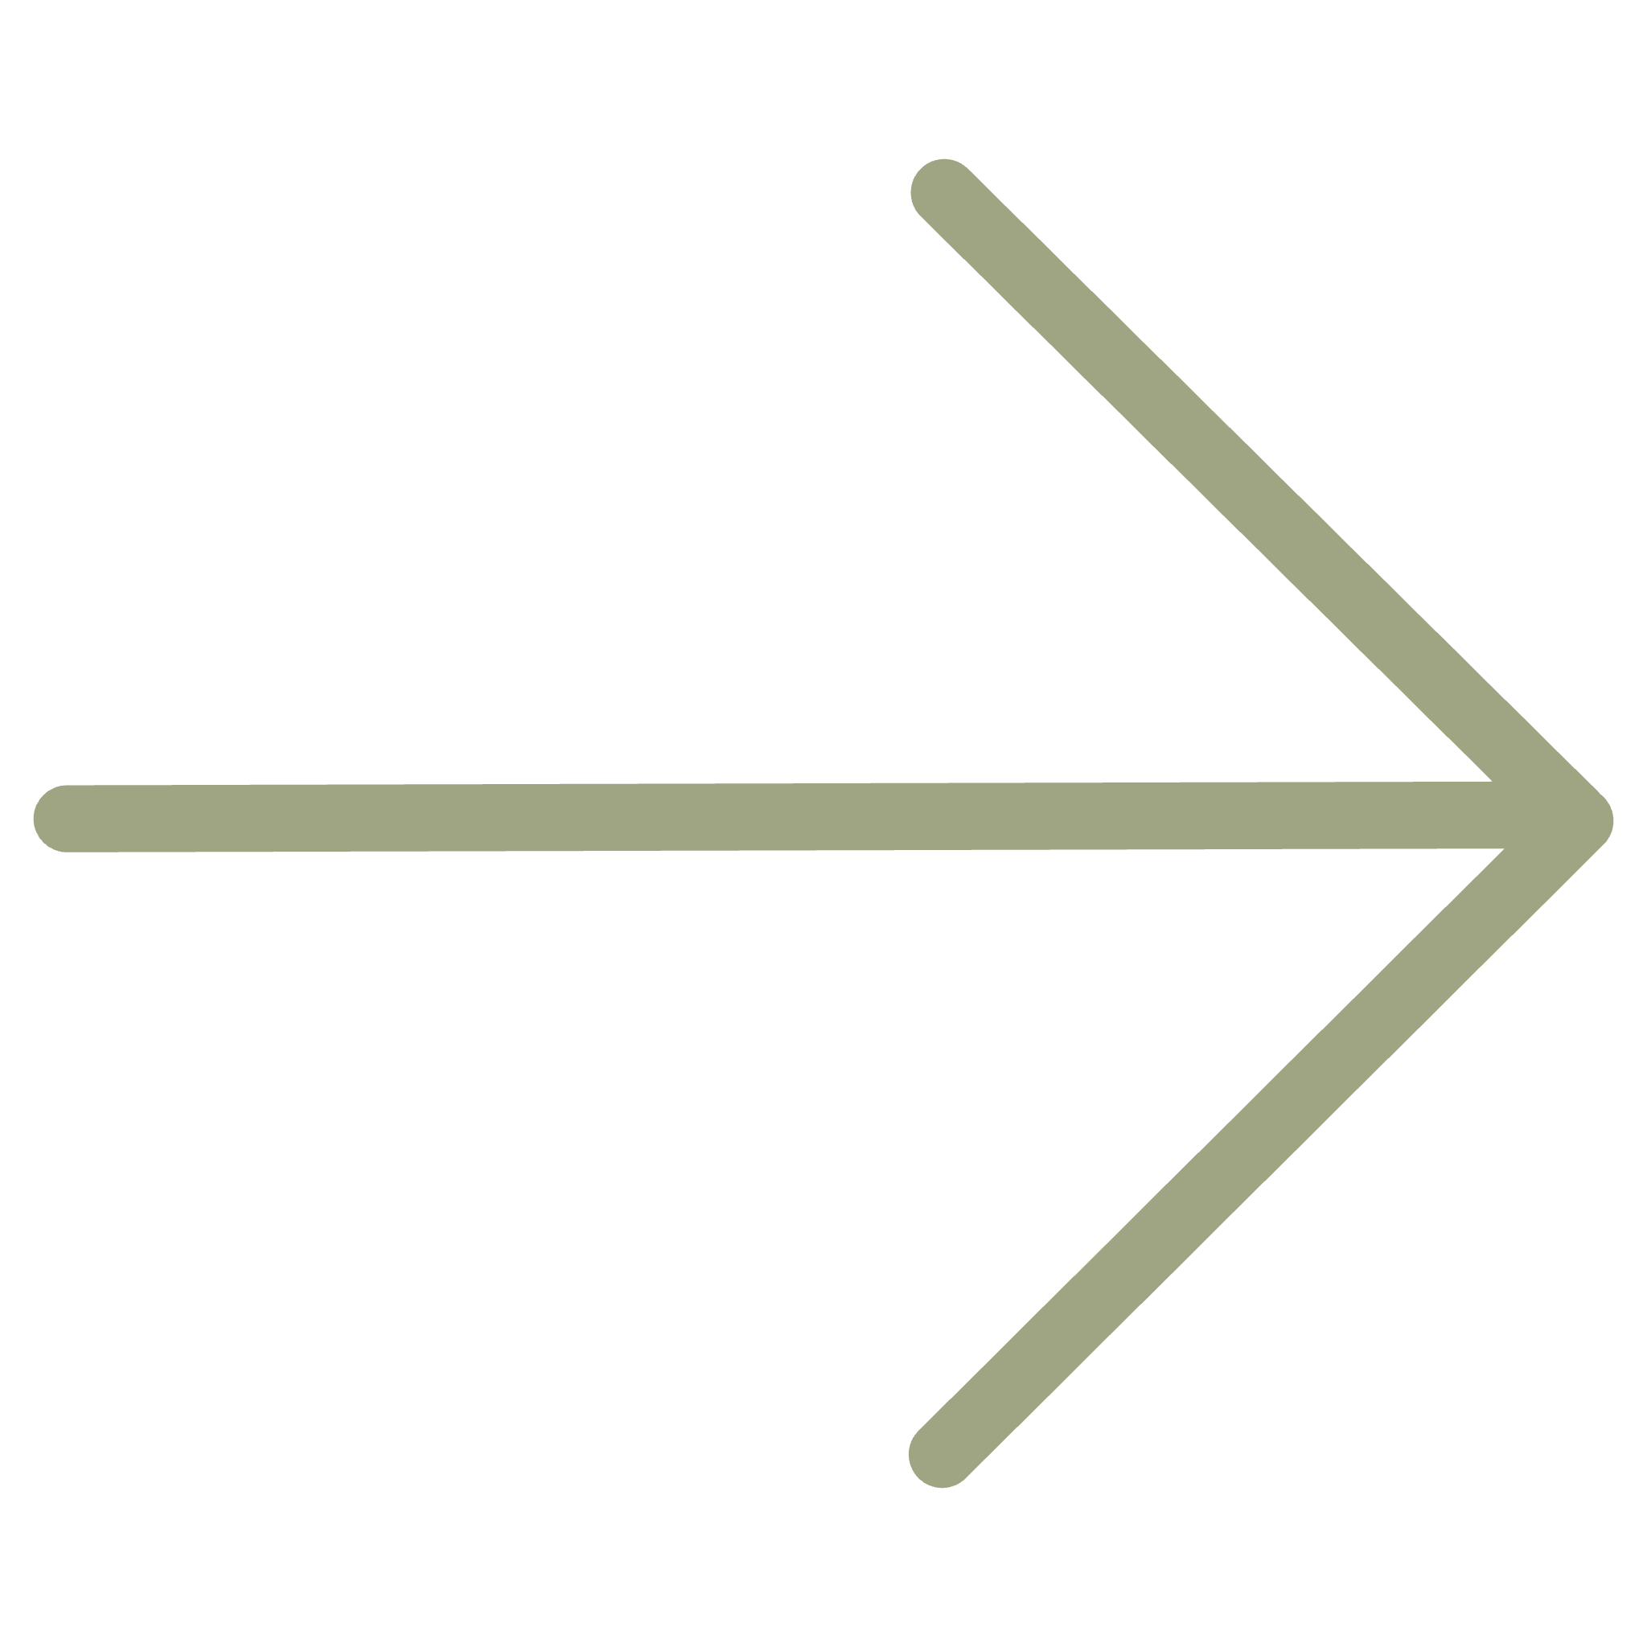
Your Reflection
The written materials cover the industry structure in more detail. As you read, reflect on these questions:
Where would you want to position yourself in this landscape?
What does the disruption mean for that choice?
How do your values inform your career choices?
COMING UP NEXT
The different roles consultants play, and why they are brought in – and why this matters

